Slide 1
BINARY BRAINS PRESENTS
MATHAN KUMAR M
9920004608
Smart Street Light Metering System
ARSALAN KHAN
9920004669
IBM
ICE
SATHISH S
9920004677
AHMAD MOHIUDDIN
9920004716

Slide 2

PROJECT OUTLINE
INTRODUCTION
DATASET
VISUALIZATION
MOVEMENT DETECTION
EXCESS POWER CONSUMPTION
FAULTY BULB ALERT
BILL GENERATION
CONCLUSION

Slide 3

INTRODUCTION
The world is moving towards automation. From virtual personal assistants to self driving cars, everything seems to be getting automated.
Streets lights are one such sub-domain that can be fully automated resulting in significantly lesser power consumption and easy maintenance.
Our project aims to build a smart
Light metering system which controls the intensity based on various factors along with recording the power consumption on daily basis.

Slide 4
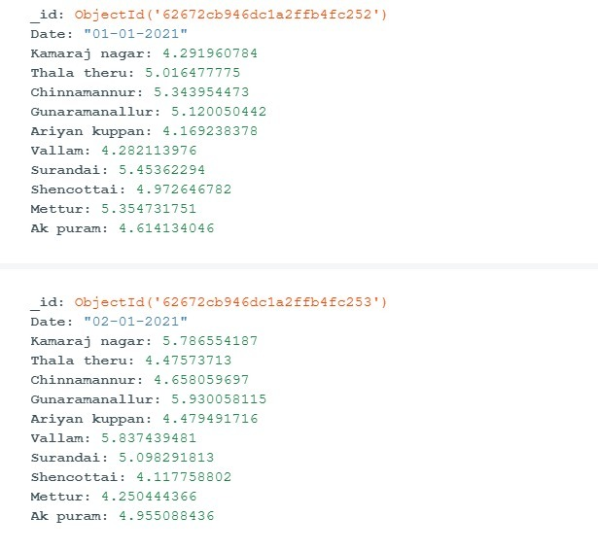
DATASET
Assuming the total number of areas to be 10 which contain a maximum of 4 street lights, each having a wattage of 70( as the general case of TNEB data). We have created a dataset of entire year's power consumption for those 10 areas. Power consumption differs depending on various factors including season, month etc
We have used MONGODB database to store and retrieve data.

Slide 5
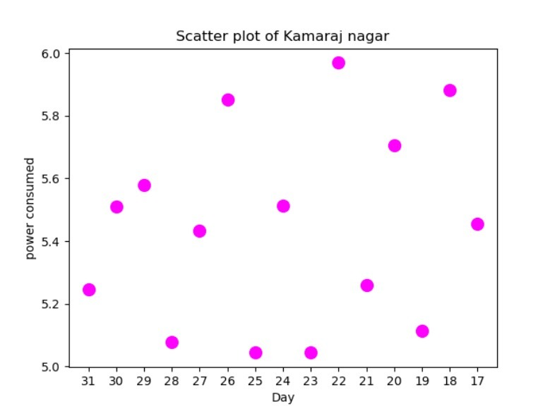
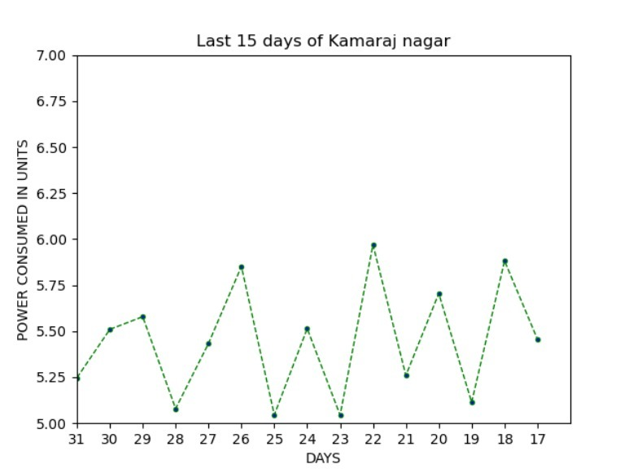
VISUALIZATION

Slide 6
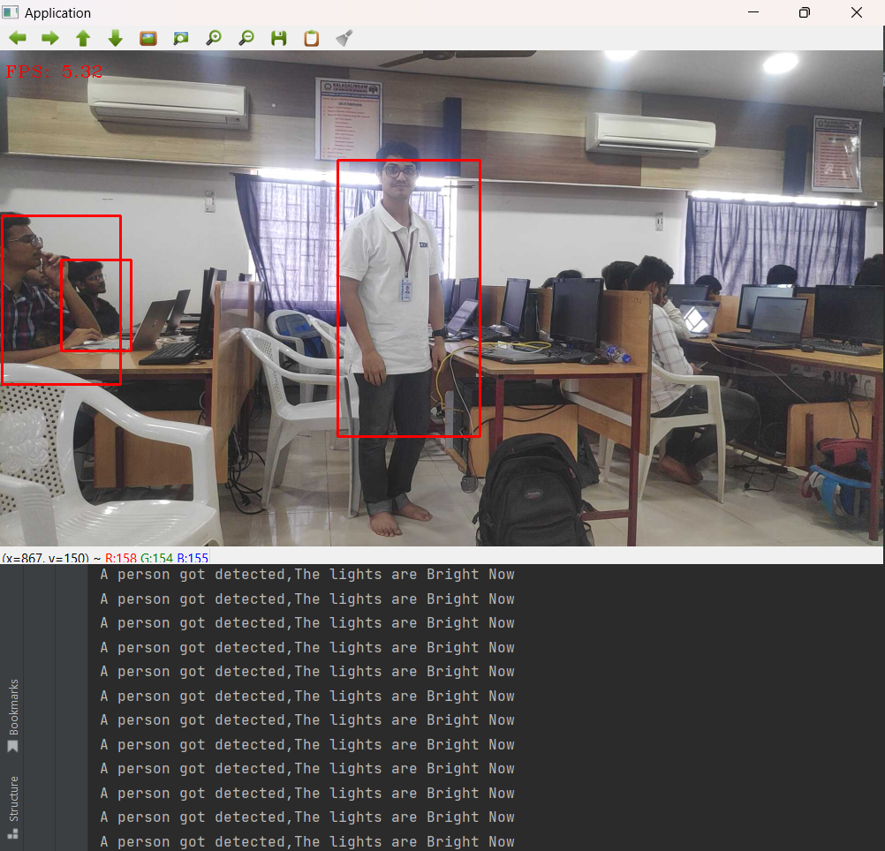
MOVEMENT DETECTION
In the problem statement it is clearly mentioned that the intensity of the light should be maximized when there is human movement. So in that regard, to detect human movement we have used MobileNetSSD caffe model which works by Deep Neural Networks

Slide 7
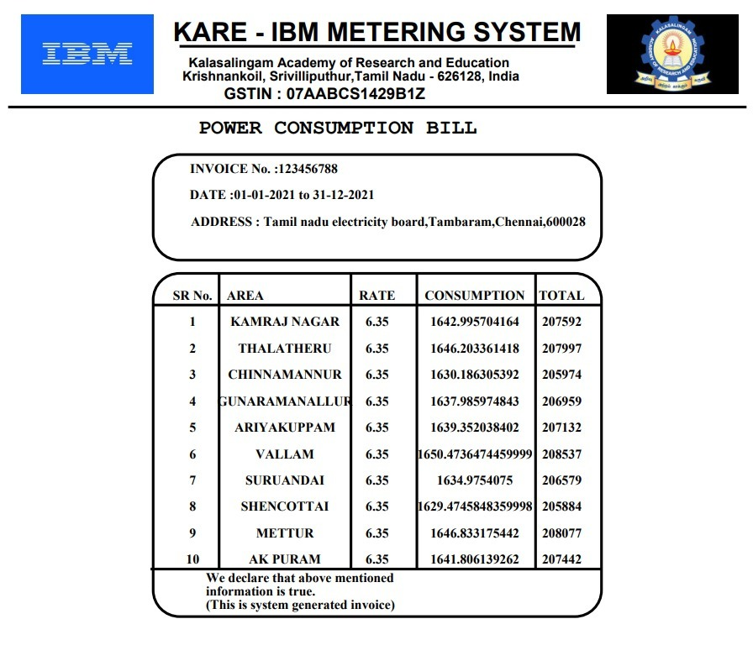
BILL GENERATION
The entire year’s bill calculation has been automated and sent to the concerned department through an automated email service.

Slide 8
FAULTY BULB ALERT
When a fault arises in a bulb in any area, the department gets a notification alert that this particular light from this particular area is faulty. The message also asks for the repair.
EXCESS POWER CONSUMPTION
If power consumption goes beyond a threshold level, which is the average
power consumed in the last 15 days, then the system will generate an alert message
to lower the consumption.

Slide 9
---
Automation of streetlights will help both in reducing overall power consumption as well as better life of the streetlights. Faulty bulbs can be easily located and the entire man power required can be reduced significantly. We are looking forward to integrate our project with IoT to have better performance and better results and later publish it as a paper in a reputed International conference.
CONCLUSION

Slide 10
THANKS FOR WATCHING

